Slide 1


HTML Events

Slide 2

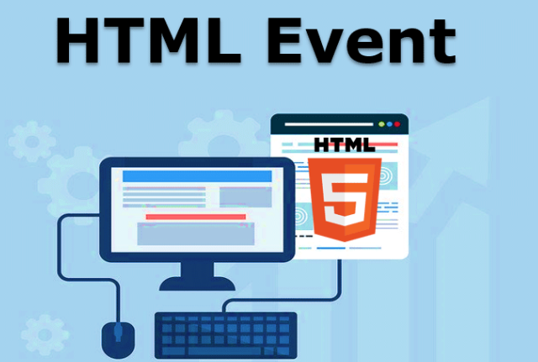
Introduction to HTML Events
HTML events allow you to add interactivity and dynamic behavior to your webpages.

Slide 3

Why to use HTML Events
Events enable you to perform tasks like validating user input, updating content dynamically, handling form submissions, creating interactive menus, and much more.

Slide 4
Types of HTML Events
Window Event
Form Event .
Keyboard Event .
Mouse Event .
Clipboard Event .
Media Event

Slide 5

THANK YOU

